Slide 1
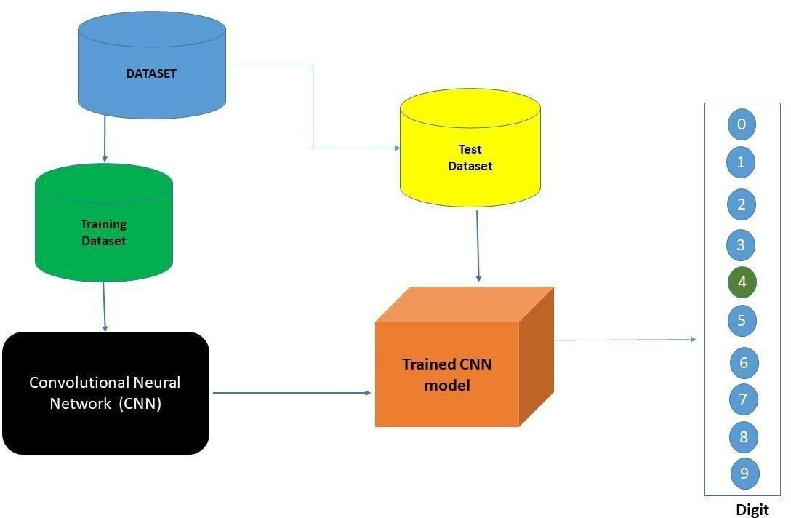
Project Design Phase-II Technology Stack (Architecture & Stack)
Date | 26 October 2022
Team ID | PNT2022TMID18806
Project Name | A Novel Method for Handwritten Digit Recognition System
Maximum Marks | 4 Marks
Technical Architecture:
The architectural diagram of the model is as below and the Technology used is shown in Table1

Slide 2
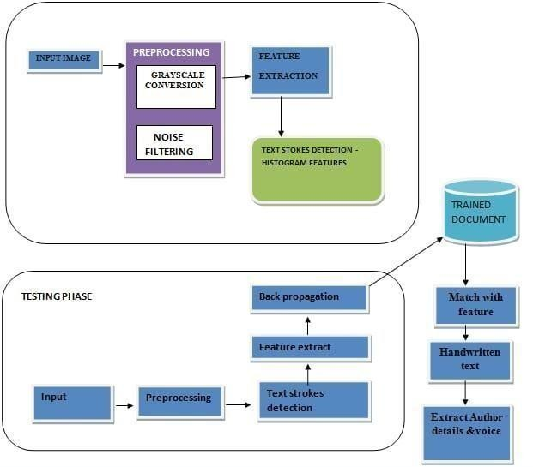
FIG. 1. BLOCK DIAGRAM

Slide 3
Table-1 : Components & Technologies:
S.No | Component | Description | Technology
1. | User Interface | How user interacts with application e.g., Mobile Application | HTML, CSS, JavaScript / Angular JS / Node Red
2. | Application Logic-1 | Logic for a process in the application | Java / Python
3. | Application Logic-2 | Logic for a process in the application | IBM Watson STT service
4. | Application Logic-3 | Logic for a process in the application | IBM Watson Assistant
5. | Database | Data Type, Configurations etc. | MySQL, NoSQL, etc.
6. | Cloud Database | Database Service on AI in cloud | IBM DB2
7. | File Storage | File storage requirements | IBM Block Storage or Other Storage Service or Local Filesystem
8. | External API-1 | Purpose of External API used in the application | IBM Weather API, etc.
9. | Internet of Things Model | Purpose of AI Model is for integrating the sensors with a user interface. | IBM AI Platform
10. | Machine Learning Model | Purpose of Machine Learning Model | Object Recognition Model
11. | Infrastructure (Server / AI) | Application Deployment on Local System / AI Local Server Configuration AI Server Configuration | Local, Kubernetes, etc.

Slide 4
Table-2: Application Characteristics:
S.No | Characteristics | Description | Technology
1. | Open-Source Frameworks | Deep leaíning fíamewoíks can help you upload data and tíain a deep leaíning model that would lead to accuíate and intuitive píedictive analysis. | Tensorflow, PyTorch
2. | Security Implementations | The system should automatically be able to authenticate all users with their unique username and password | NA
3. | Scalable Architecture | The system should be able to handle 10000 users accessing the site at the same time | NA
4. | Availability | Information is restricted to each users limited access | NA
5. | Performance | Should reduce the delay in information when hundreds of requests are given | Google Co-Lab Pro/ Require high end system.

